Slide 1
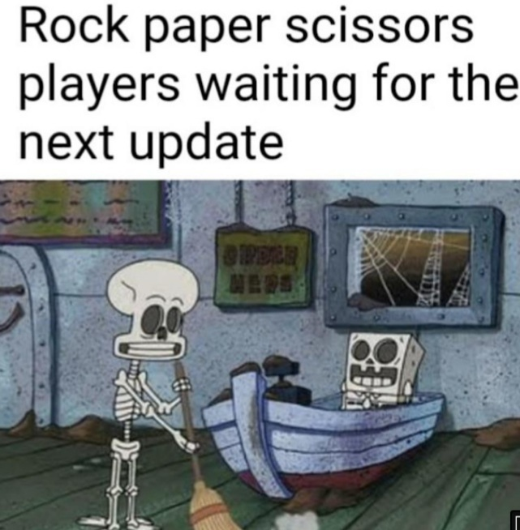
Rock, paper, scissors, lizard, Spock.
Design Problem 2

Slide 2
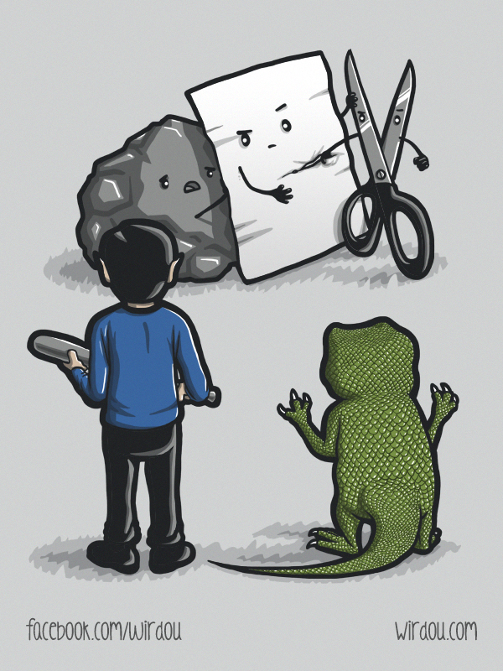
Agenda
Problem Background
Learning Objectives
Coding

Slide 3
Our problem background starts in a famous TV show apartment…

Slide 4
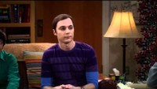

Slide 5
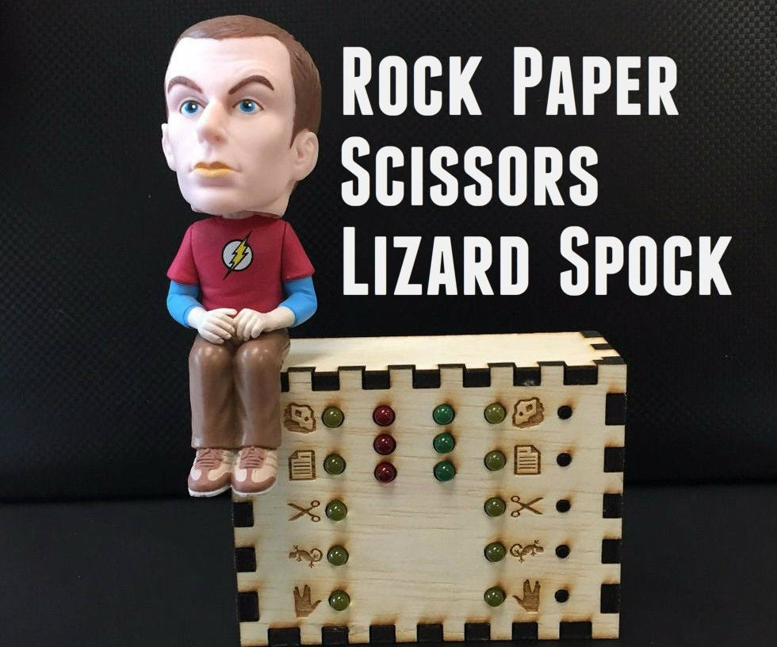
Background
Will rely on conditional statements and imported libraries to create a basic computer game!
Goal Write a Python program that using conditional statements and user input to play Rock-Paper-Scissors-Lizard-Spock against a computer program with random choice selection.

Slide 6
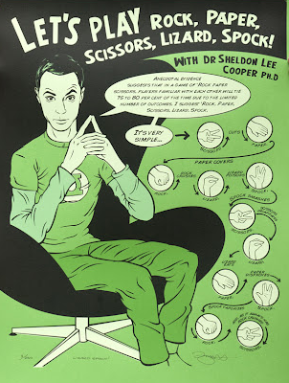
Learning Objectives
Practice using many conditional statements.
Practice with user input.
Practice creating custom functions.
Practice with built-in libraries.

Slide 7
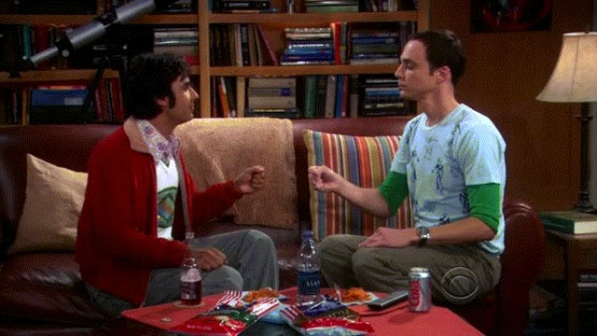
Rock, paper, scissors, lizard, Spock.
Design Problem 2

